Slide 1
Excel Basics: Basic skills for Assignments
Module 1
‘Expecting all children the same age to learn from the same materials is like expecting all children the same age to wear the same size clothing.’ –Madeline Hunter

Slide 2
Agenda
Excel Overview
Navigation
Menus
Excel Structure
Workbook
Worksheet
Rows, Columns
Formats
Font, fill, alignment, borders
Wrap Text, Merge & Center
Dates, Currency, %
Copy, dragging, pasting, etc.
Basic Math operations
References (Relative, Absolute)

Slide 3
Excel Structure and Basic Functionality
Open a new Workbook
Understand the structure of Excel
Format cells and text
Copy/paste, drag and fill cells
Understand basic math operations

Slide 4
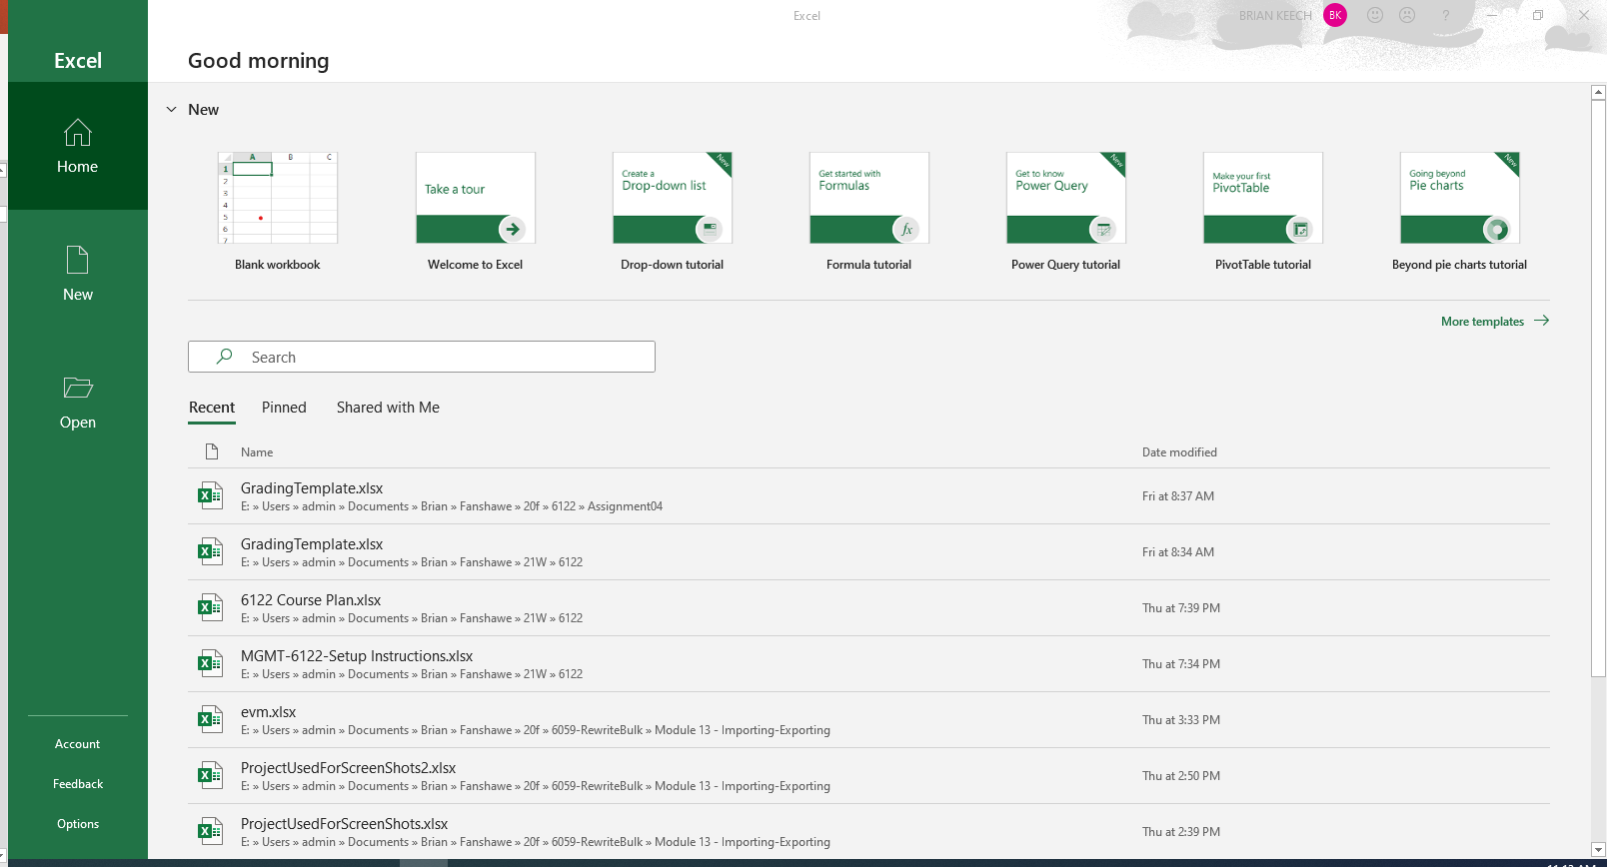
Open Excel
New Blank Workbook

Slide 5
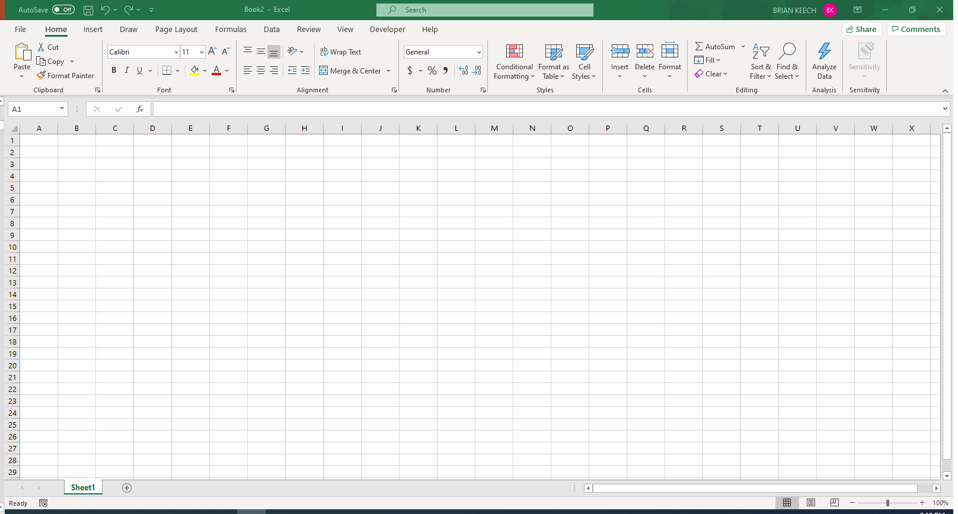
New Blank Worksheet
Workbook
Menu bar
Ribbon
Column
Row
Worksheet (tab)

Slide 6
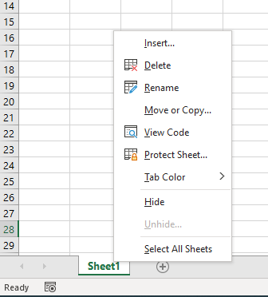
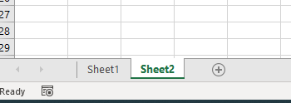
Worksheet – New and Customizing
Delete
Tab Colour
Add New Worksheet
(Right click) Customization

Slide 7
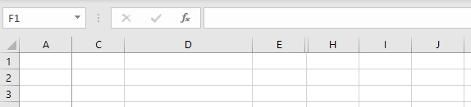
Worksheet - Columns
Columns
Labelled by Alphabetic character A-XFD (A,B,…AA, AB…, XFD)
Can be sized
Can be hidden/Unhidden
Can freeze panes
Freeze Panes
Size Changed
F and G Hidden

Slide 8
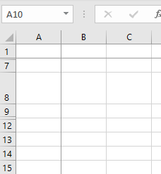
Worksheet - Rows
Rows
Labelled by Numeric character 1 – 1,048,576
Can be sized (manual and auto)
Can be hidden/Unhidden
Can freeze panes
Freeze panes
Size Changed
10 and 11 Hidden

Slide 9
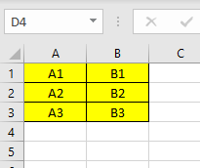
Worksheet – cells and Ranges
Cells
Name by (Column, Row) such as C1, A22, AA12, etc.
Can have formatting, word wrap
Can be merged
Ranges
Denotes a group of cells
A1:B3 would give us cells A1, A2, A3, B1, B2, B3
Selected Range

Slide 10
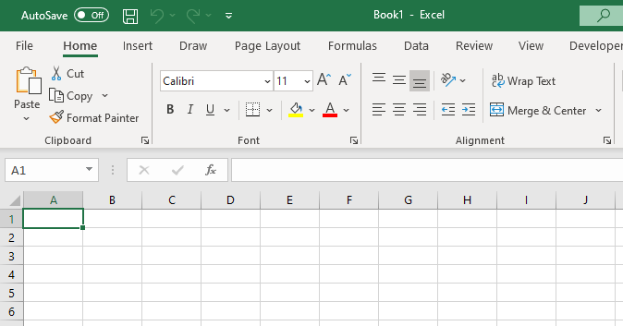
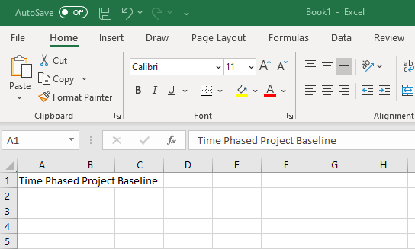
Entering Data
Type Date in Formula bar
Formula bar functions
Select a cell
Type date in Cell

Slide 11
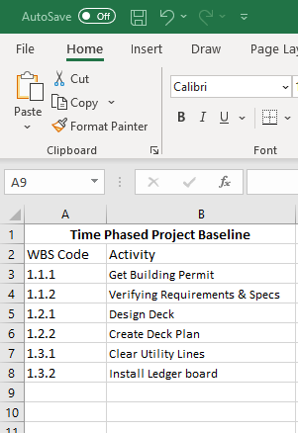
Data entered in Rows and Columns

Slide 12
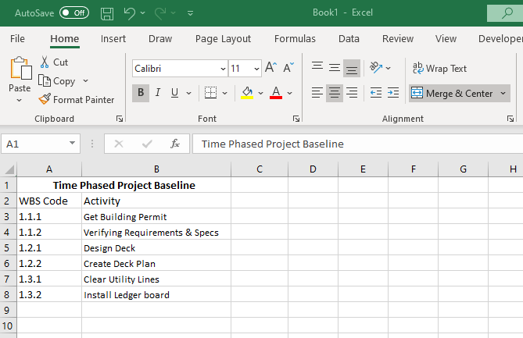
Text Formating and Alignment
Vertical Alignment
Font and Size
Horizontal Alignment
Bold
Indent
Font Colour
Fill Colour
Borders

Slide 13
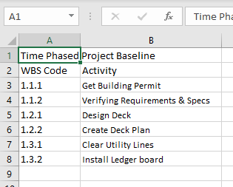
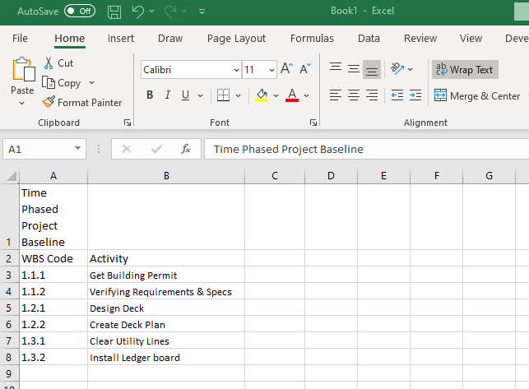
Wrap
Select cell(s)
Select Wrap
Wraps text in cell

Slide 14
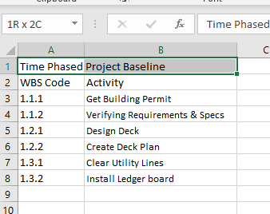
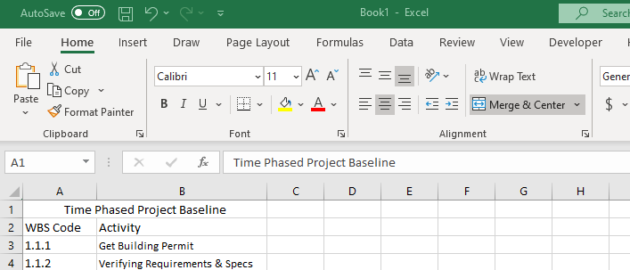
Merge and Centre
Select both cells
Select both cells

Slide 15
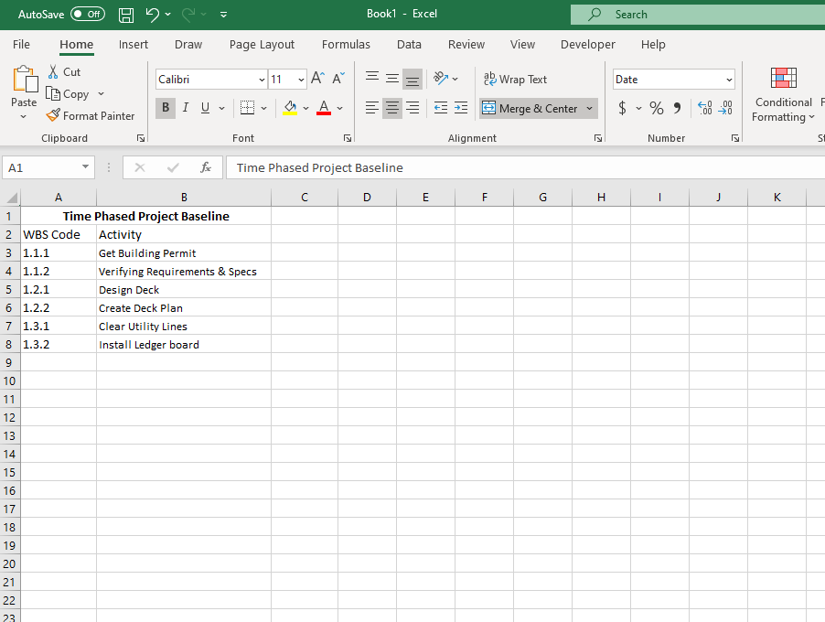
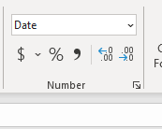
Formatting Data
Cell(s) Format
Detailed/ Custom
# of Decimal Points
Note:
These formats are really just that … formats.
They DO NOT convert data.
They display in the chosen format if they can.
Ex: If a cell is not stored as a date and you apply a date format, it will not change.
Percentage (%)
Currency

Slide 16
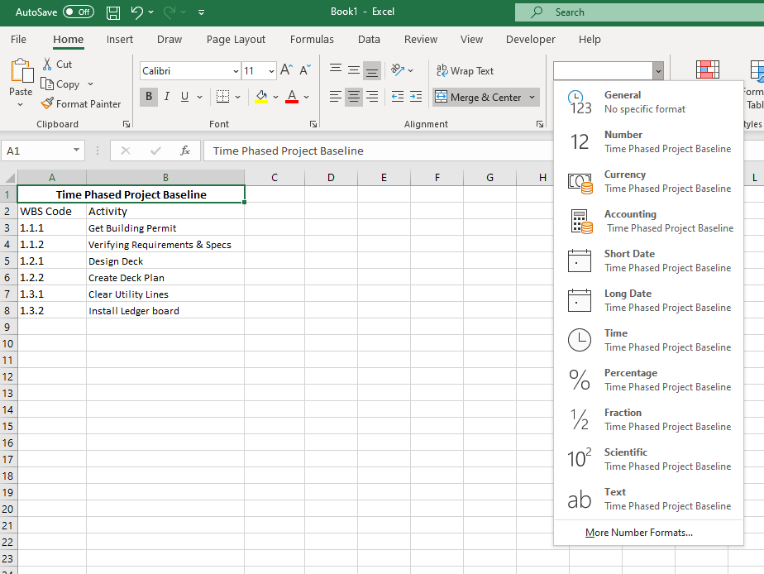
Formatting Data
Cell(s) Format
Currency
Dates
Custom Formats

Slide 17
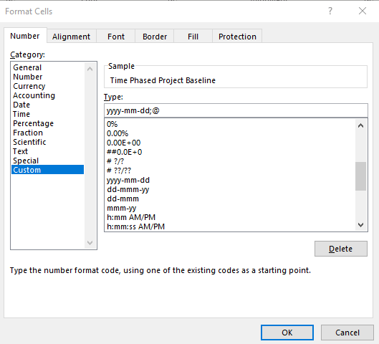
Custom Formats
Select Data Type
Enter Mask for Custom Format
Select Format

Slide 18
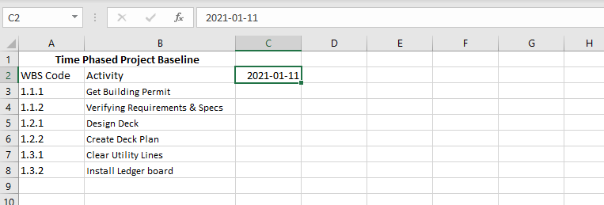
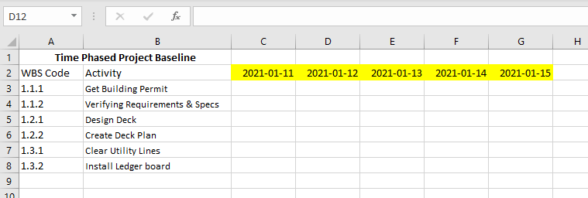
Fill
Drag/Fill Indicator
Filled Sequential Values

Slide 19

Fill – Control Drag
Ctrl-Drag/Fill Indicator
Copies Values

Slide 20
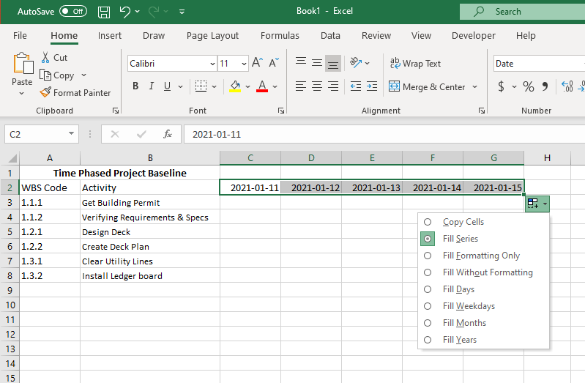
Fill - Advanced
Advanced Fill Options

Slide 21
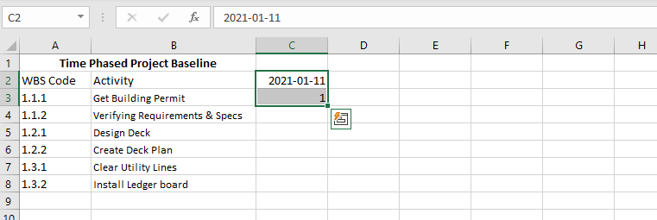
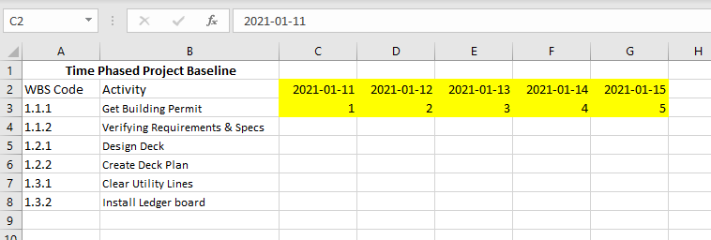
Fill – Multi-row/Multi-Column
Multi-Row Fill
Multi-row
Incremental Values

Slide 22
Excel Example
Create a new Workbook
Create a worksheet
Practice:
Text format
Borders
Column, Row Sizes
Merge/Wrap
Date Formats
Drag/Fill Data
Copy/Paste Data
Module 1
Exercise 1
Notes:
Now we should go into Excel and demonstrate all the concepts covered in the preceding slides. We should end up with a file that resembles the workbook in the included in this module.

Slide 23
Excel References
Understand cell references
Create a formula with both absolute and relative references
Drag/Fill data

Slide 24
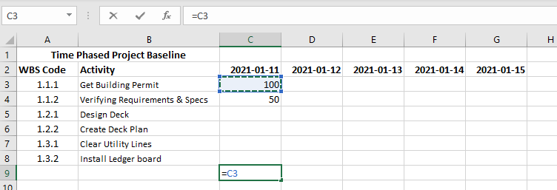
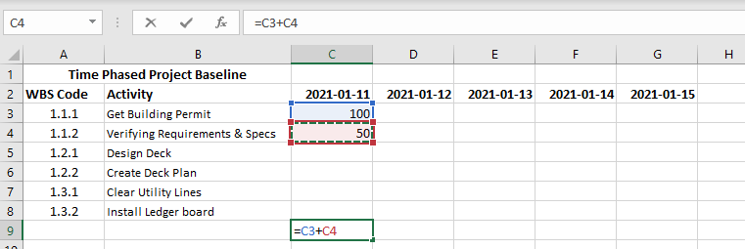
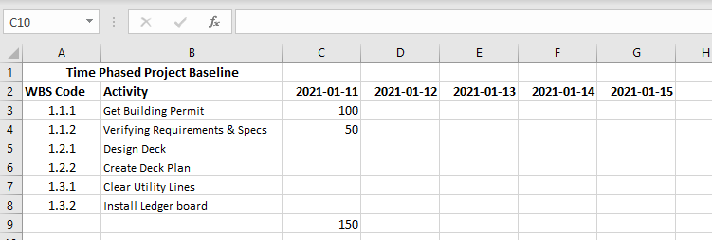
Math Operations
Select Cell C3
Press “=“ and Then
Select Cell C4 and hit Enter
Press “+“ and Then

Slide 25
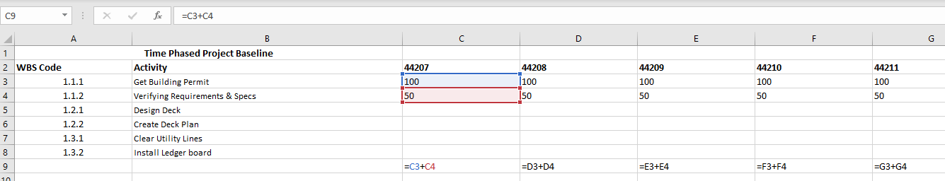
Relative References
Relative References
When you copy the cells it will automatically change the row/column relative to the new location
Above we copied C9 across to D9-G9 and the addition formula changed for each row.
(same would happen with columns if we copied in the other direction)
Notice Columns Changed
Notice Columns Changed
Notice Columns Changed

Slide 26
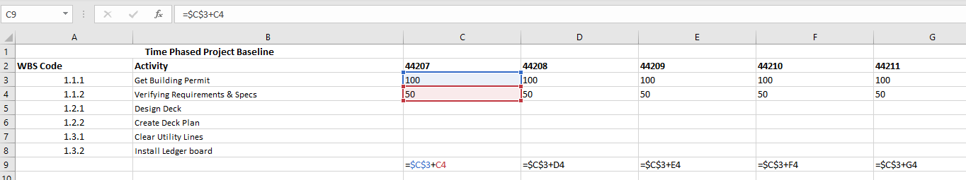
Absolute References
Absolute References ($)
When you copy the cells it will not change the row/column
Above we copied C9 across to D9-G9 and the addition formula changed for only one variable.
(same would happen with columns if we copied in the other direction)
How to change to absolute
You can just add a $ in front of the row or column
You can keep pressing F4 to cycle through the options
C3
C$3
$C3
$C$3
Notice Columns Changed
Notice Columns Changed
Notice Cell with $ didn’t change

Slide 27
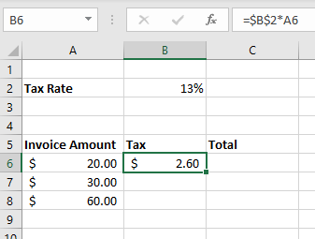
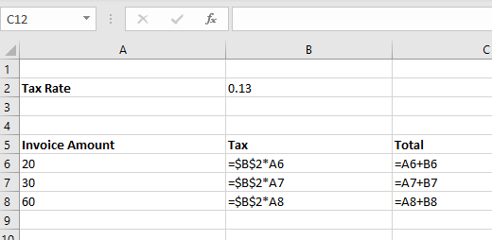
Absolute and Relative Example
If I fill this down it will always use B2 as the tax rate
Absolute
Relative
Relative
Relative

Slide 28
References Example
Create a relative reference
Create an absolute reference by typing a $
Use F4 to cycle through references
Build a sheet like in example.
Module 1
Exercise 2

